Slide 1
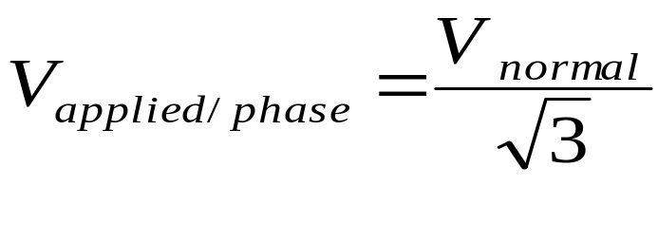
Star-delta starting
The machine, designed for delta operation, has all the six stator leads brought out to the terminal box.
The windings are connected in star during the starting period and in delta during normal running conditions.
During starting,

Slide 2
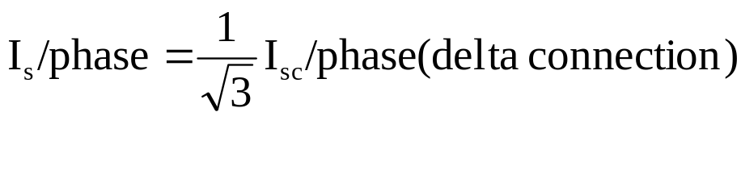
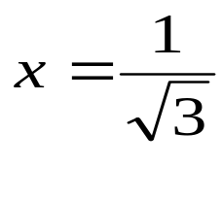
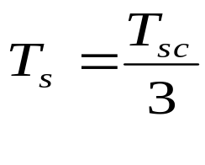
Star-delta starting cont’d
Therefore at starting
This means that the starting line current when star connected is one-third the value for delta connection.
The motor behaves as if the autotransformer was employed with .
The starting torque where T_{sc} is the starting torque for delta connection.

Slide 3
This method suffers from the same disadvantage as the autotransformer starting in that all three lines must be opened simultaneously during the change-over from the starting to normal running conditions.
The method is effective if the starting torque is adequate and cheap so long as the supply voltage does not exceed about 3 kV . Why?

Slide 4
At voltages exceeding 3 kV, excessive number of stator turns will be needed for delta running.
Typical circuit diagram of automatic star-delta starter (open-circuit transition type) is shown on the next slide
Timer setting is around 10 s. For lightly loaded motor, the setting is slightly less and for heavily loaded motor, it is slightly more.
With this method repeated starting can be obtained.

Slide 5
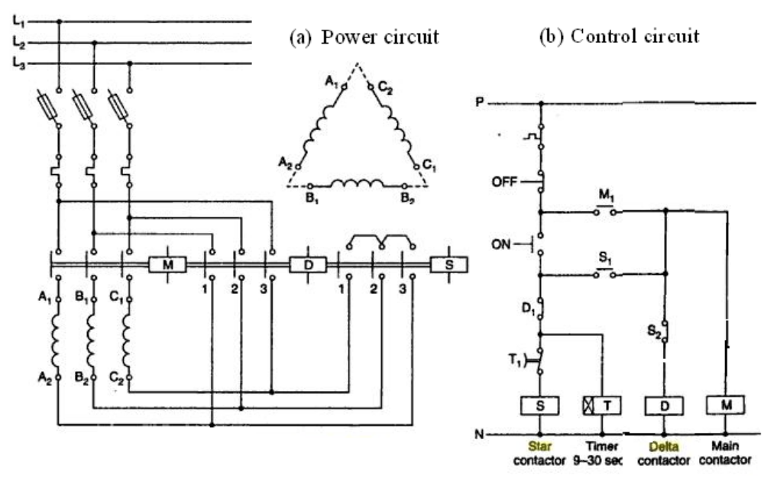

Slide 6
When the ON pushbutton is pressed, the star contactor S picks up and closes the circuit of the main contactor M coil through its NO auxiliary contact S₁.
At the same time, normally closed contact S₂ interrupts the circuit of the delta contactor.
The main contactor M gets hold through it NO auxiliary contact M₁ whereas the star contactor S gets hold through both S₂ and M₁.

Slide 7
When the main and the star contactors are energized, the motor starts to run star-connected.
This continues until the timer times out and opens its NC delayed contact T₁ to de-energize the star contactor S.
When the star contactor S drops out, its contact S₁ opens and its contact S₂ closes.
The closing of S₂ energizes the delta contactor.

Slide 8
When the delta contactor picks up, it opens its NC auxiliary contact D₁ to interrupt the coil circuit of the star contactor S, thus interlocking against the motor being switched on again while running in delta connection.
While the motor is running, the main and the delta contactors are energized while the star contactor and the timer are de-energized.

Slide 9
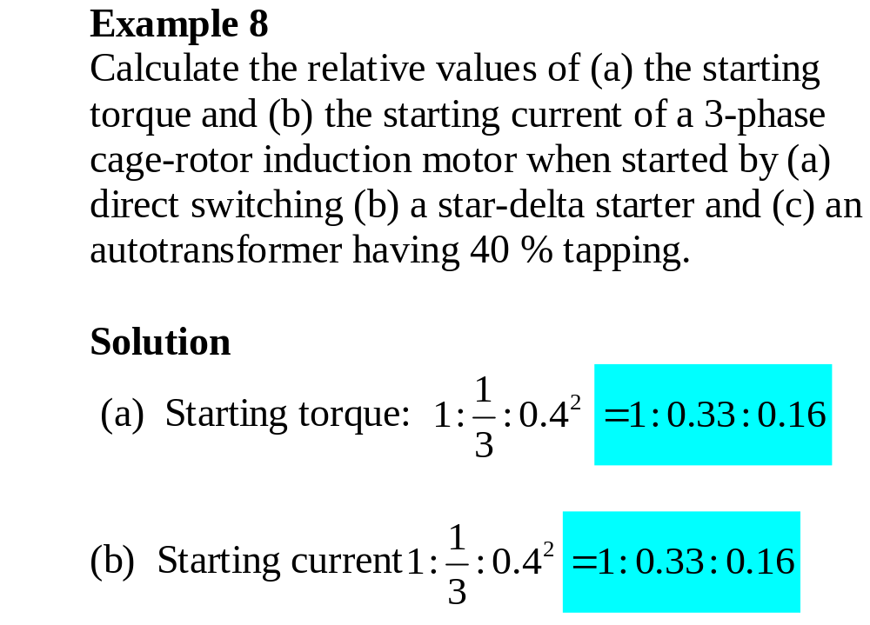

Slide 10
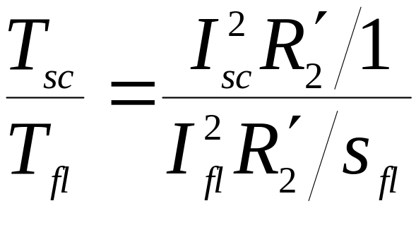
Starting torque for induction motors
The ratio between starting torque and full-load torque is usefully expressed in terms of the stator currents.
Since the referred rotor current is approximately equal to the input current, and at starting s = 1

Slide 11
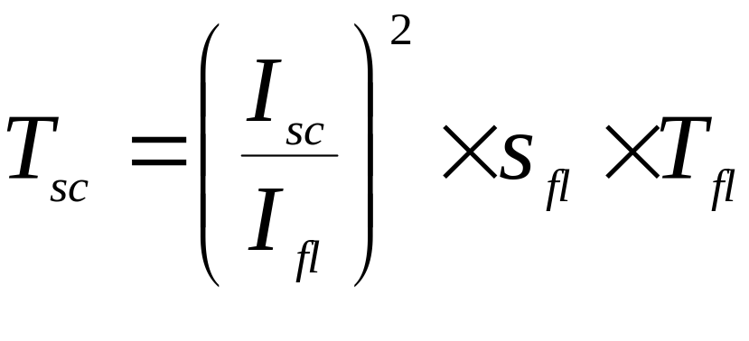
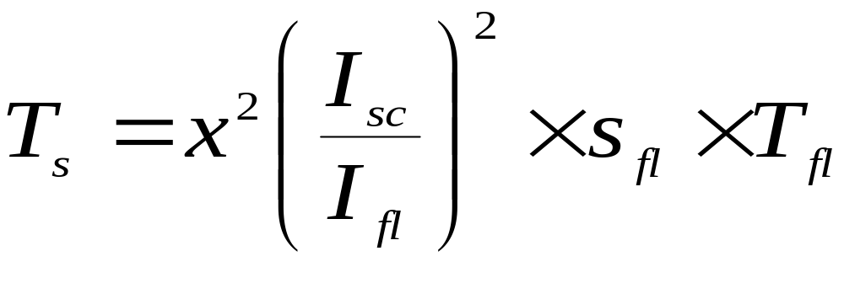
Starting torque for induction motors
From the previous equation
In general

Slide 12
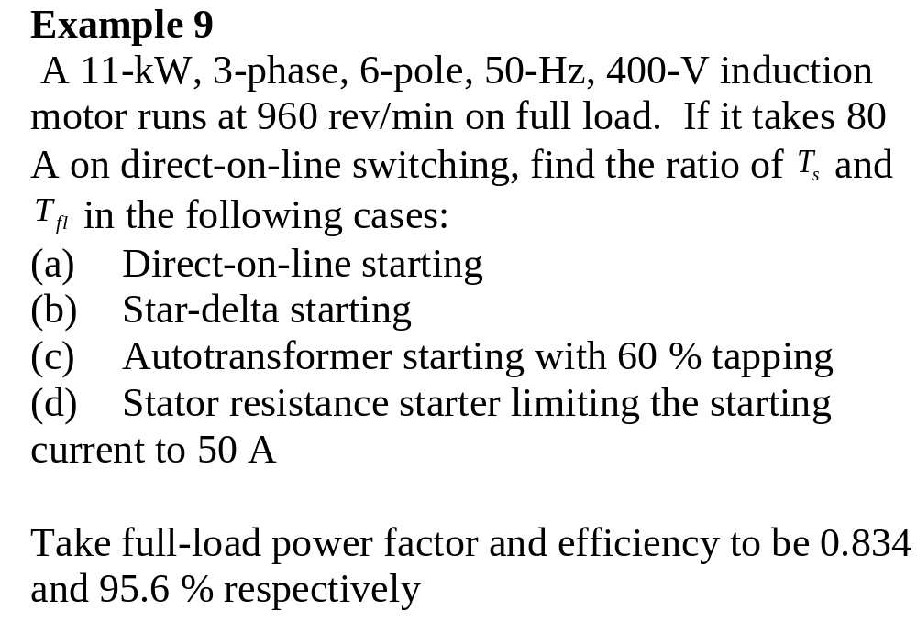

Slide 13
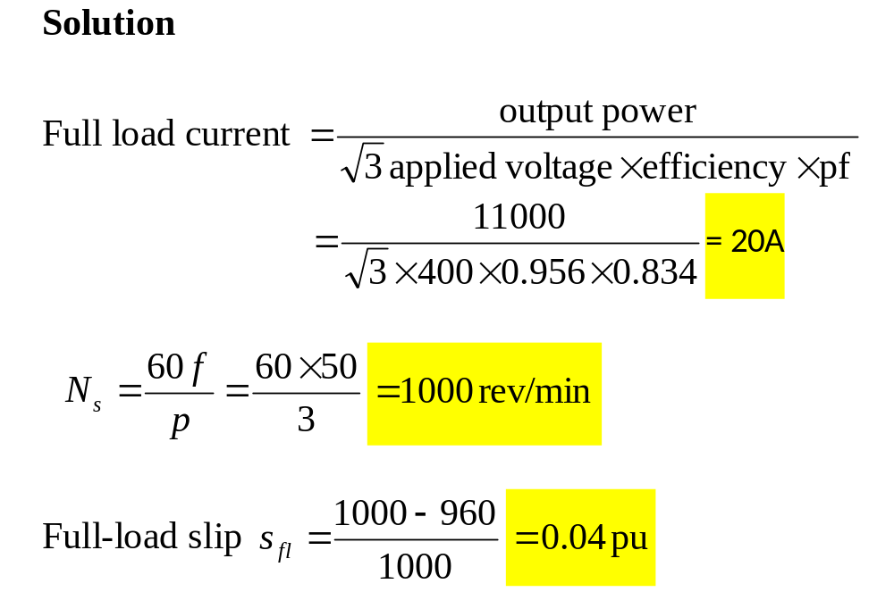

Slide 14
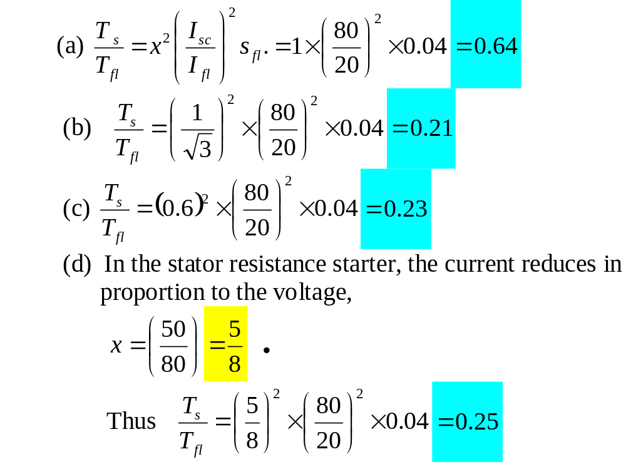

Slide 15
Slip-ring induction motor
The starting current is reduced by introducing additional rotor resistance during starting.
This can also be made to increase the starting torque available since the slip at which maximum torque occurs, increases as the rotor resistance increases.

Slide 16
Slip-ring induction motor cont’d
The external rotor resistance is generally reduced in steps as the machine runs up to speed.
The slip-ring motors are suitable for heavy, frequent starting and accelerating duty-cycles.

Slide 17
High-torque cage motors
The plain squirrel cage induction motor is simple, robust, low-cost and requires little maintenance.
However, it gives a low starting torque with a very large starting current.
The most usual type of standard low-resistance cage motor gives 35-45 % of full-load torque with 2.5-3.5 times full-load current, on a start at 60 % of normal voltage.

Slide 18
Squirrel cage motors with sophisticated cage arrangements have been designed to obtain high torque cage motors for onerous starting conditions without sacrificing the simplicity, efficiency and cheapness of the cage motor.
The cage arrangements in use can be classified in two categories :
  Deep-bar cage
  Double-cage rotors

Slide 19
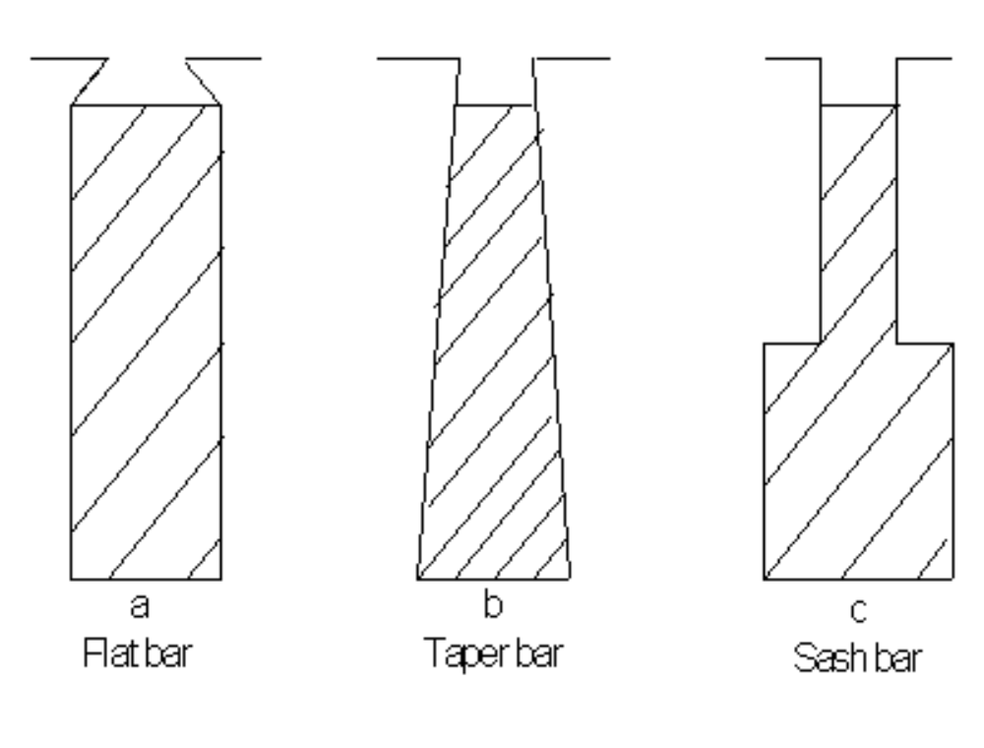
Deep-bar cage
The slot bars are designed with special shapes so that skin effect is pronounced.
Some typical bar shapes:

Slide 20
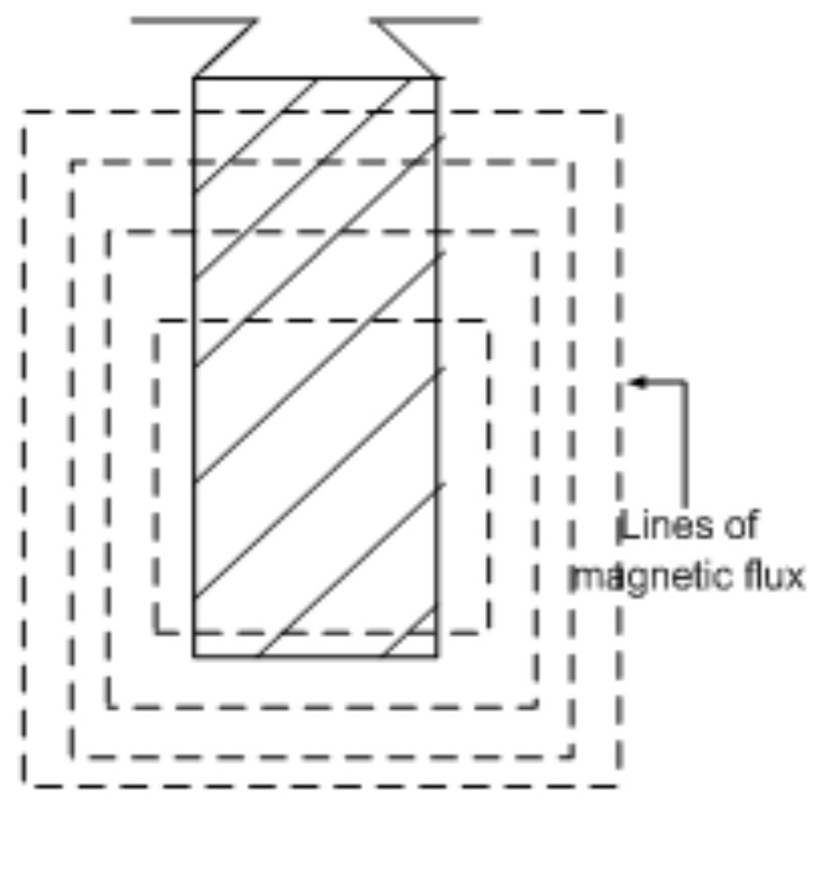
Deep-bar cage cont’d
One slot of a flat-bar rotor showing a few typical lines of flux produced by a current in the bar:

Slide 21
Deep-bar cage cont’d
The upper part of the conductor (nearer to the rotor surface) has fewer flux linkages and consequently lower reactance than the lower part.
A time-varying current is thus crowded toward the surface.
This phenomenon is known as the skin effect.

Slide 22
Deep-bar cage cont’d
Any departure from uniform current distribution increases I²R loss and hence the resistance of the conductor over its dc values.
In sinusoidal steady state, skin effect becomes more pronounced with larger current magnitudes, higher frequencies and increased conductor size.

Slide 23
Deep-bar cage cont’d
At starting with rotor frequency equal to supply frequency, the effective cage resistance of deep-bar rotor is very high and this improves the rotor power factor, current and torque.
In the normal running conditions when the rotor frequency is only a small fraction of the supply frequency the ac resistance is little different from the dc value thus giving low loss and high efficiency.

Slide 24
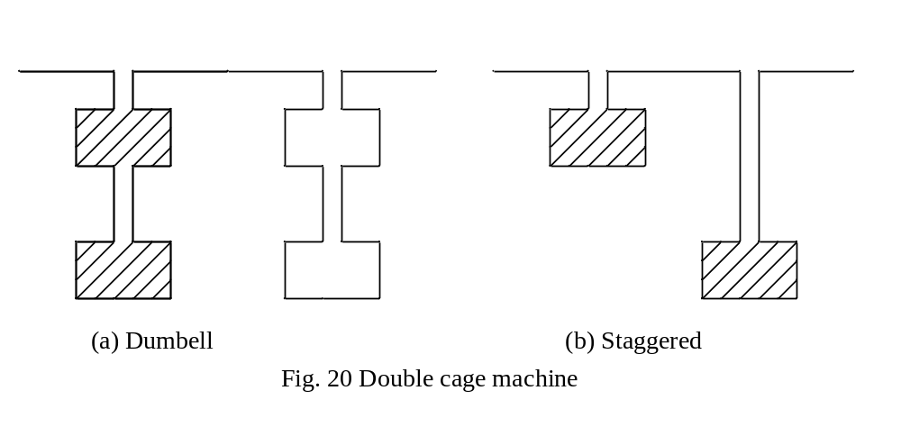
Double-cage rotors
The rotor has two concentric and separate cage windings.
The outer and inner cage winding are

Slide 25
Double-cage rotors cont’d
The outer cage which has a low leakage reactance is made with high resistance
While the inner cage made with relatively low resistance has a high leakage reactance because it is sunk deep into the iron.
At starting, when the frequency of the rotor currents is the same as the supply frequency, the outer cage which has the lower impedance takes on most of the starting current.

Slide 26
Double-cage rotors cont’d
The outer cage, being of high resistance develops a high starting torque.
When the motor is running, it is the inner cage that carries most of the current due to its lower resistance because at the small rotor frequency the leakage reactances do not matter.

Slide 27
So the two cage arrangements yield machines which have a high starting torque and a high running efficiency with reasonably small values of starting current.
The torque-speed curve of the machine can be estimated by summing the torques considered to be produced separately by the cages as shown on the next slide

Slide 28
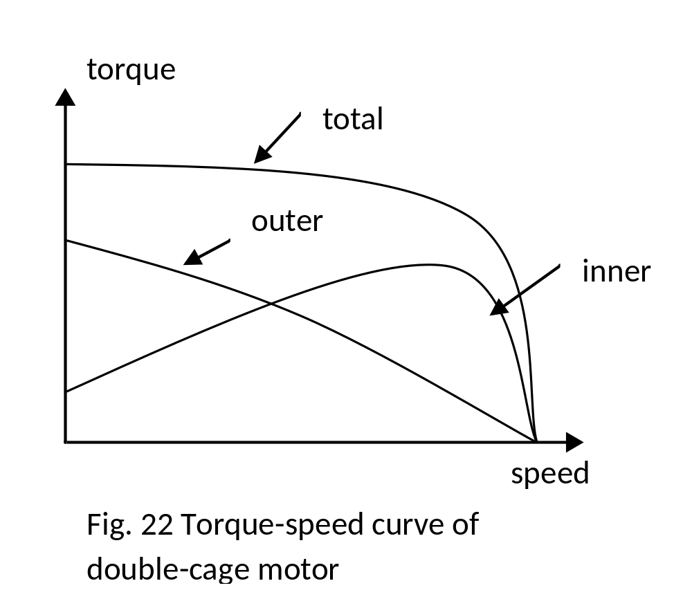

Slide 29
By varying the relative values of the resistance and reactance, a wide variety of torque-speed characteristics can be obtained.
The performance of the motor can be determined using the equivalent circuit shown below
A simplified circuit is obtained from this by putting x_{m} and r_{m} across the stator terminals.

Slide 30
